Slide 1

.NET Maui
Data Binding
Data binding and MVVM - .NET MAUI | Microsoft Learn

Slide 2
Databinding Concept
One Way
Source Object
Target Object
Two Way
One Way To Source
One Time

Slide 3
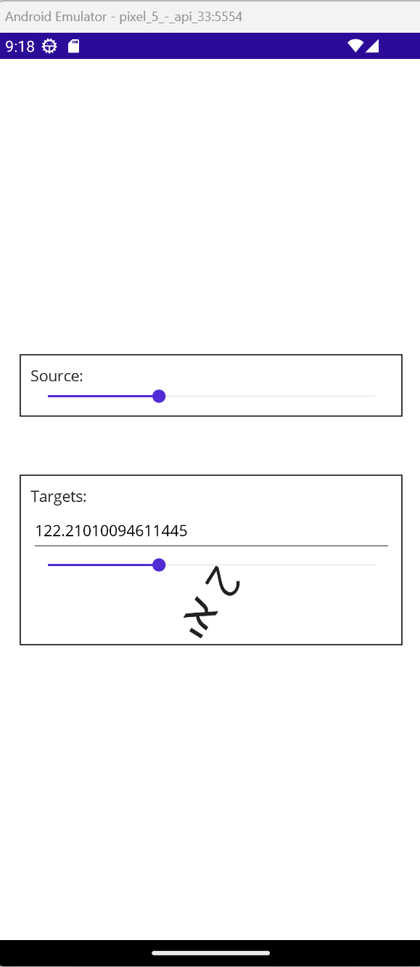
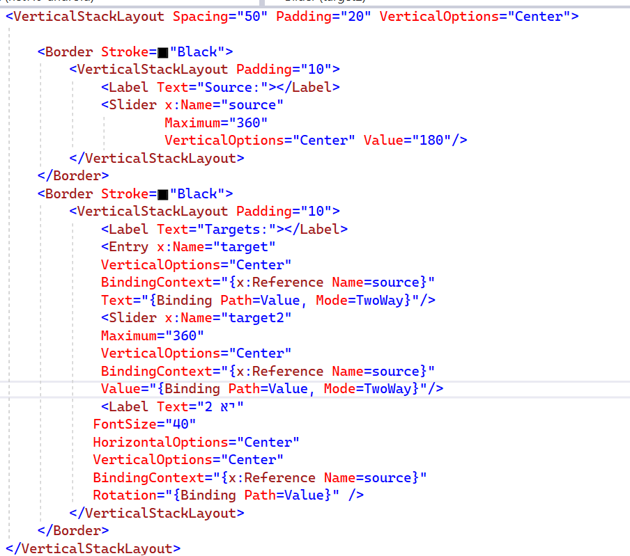

Slide 4
Databinding Concept
INotifyPropertyChanged
Property Changed Event
INotifyPropertyChanged
BindableObject
Binding Context
Source Object
Target Object

Slide 5
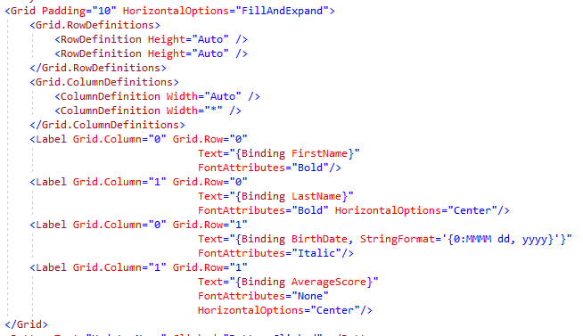
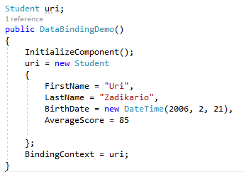
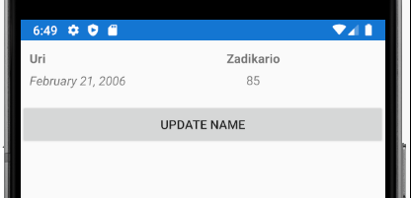
Data Binding Using home made classes
Data binding connects UI objects with Data model objects and ensures one reflects the other.
The student object uri includes properties. Instead of setting each Label text with the relevant property value, we can set the objects as the Page BindingContext and set in the XAML for each Label the proper property value to bind!

Slide 6

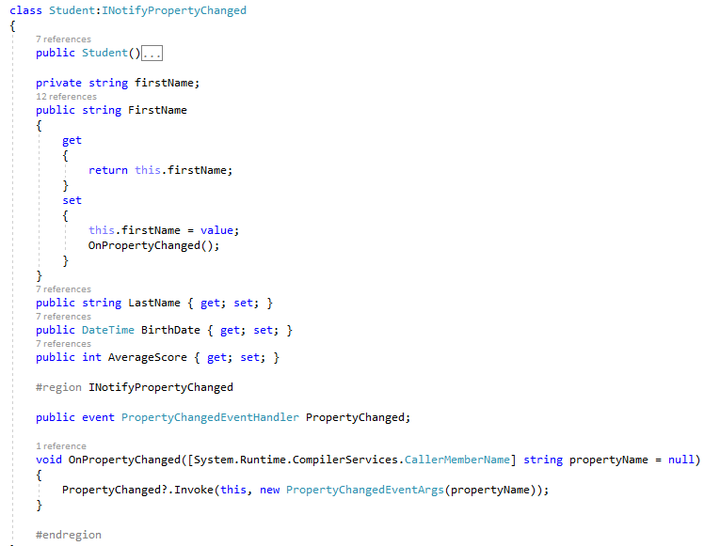
Changing the data object
Once the button is clicked we will change the data object. Note that the UI did not change the Name label! In order for the label to be changed the data object should notify the UI about every change. It can be done by implementing the interface NotifyPropertyChange
Button click event handler
INotifyPropertyChanged Interface implementation
Once a data object property is changing, the data object fires the event “PropertyChanged” that is implemented in the UI object by the Label that binds the new value to the proper label!

Slide 7

Changing the UI object
Once the button is clicked we will now change the label object. Note that the Data object did not change its FirstName property. In order for the data object to be changed the UI object should notify about the change. It can be done setting the mode of the data binding to TwoWay as follows:
Once the label text property is changing, the UI change back the data object!

Slide 8
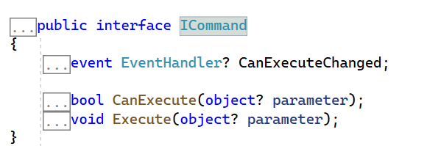
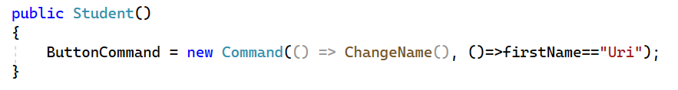
Dealing with User Interactions (Buttons and alike)
In order to deal with user interactions like clicking a button, use the Command and Command Parameter properties of a Button (and other controls).
The Command property is from type ICommand that includes the following interface:
Usually use the Command or Command<T> classes that implements Icommand and gets an action to be executed upon button click and an action<bool> to determine if button should be enabled / disabled.

Slide 9
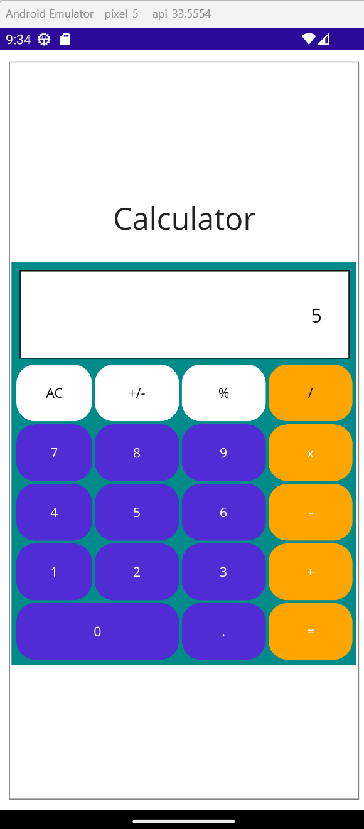
Exercise
Change the Calculator Page to use Data Binding!
Create a class “CalculatorBrain” to hold the data presented in the calculator label and all buttons interactions using commands.
Connect the page class with the brain by setting the brain as the BindingContext of the page and set the proper bindings on the page XAML tags

